Slide 1






Collision Industry Conference
Level One Sponsors
Level Two Sponsors
1-800 Radiator & A/C
3M Automotive Aftermarket
AkzoNobel Coatings
ALLDATA
AudaExplore, a Solera Company
Caliber Collision Centers
Car-Part.com
CARQUEST Auto Parts & Paint
CCC Information Services
ChemSpec
Chief Automotive Technologies
Coyote Vision Group
Square One Systems
CSi Complete & TenPoint
Insurance Solutions
Enterprise Rent-A-Car
Ford Customer Service
General Motors –
Customer Care & Aftersales
ITW Evercoat
Kent Automotive
LKQ / Keystone
Lord Corporation
Matrix Electronic Measuring
Matrix System Automotive Finishes
Mitchell International
National Coatings
Norton Saint-Gobain
Paint, Body & Equipment Distributors,
a segment of AAIA
Parts Trader
Sherwin-Williams Automotive Finishes
State Farm Insurance
Sterling Autobody Centers
Toyota Motor Sales, USA
United Recyclers Group

Slide 2
Collision Industry Conference
November 2013
Las Vegas Nevada
Notes:
2

Slide 3
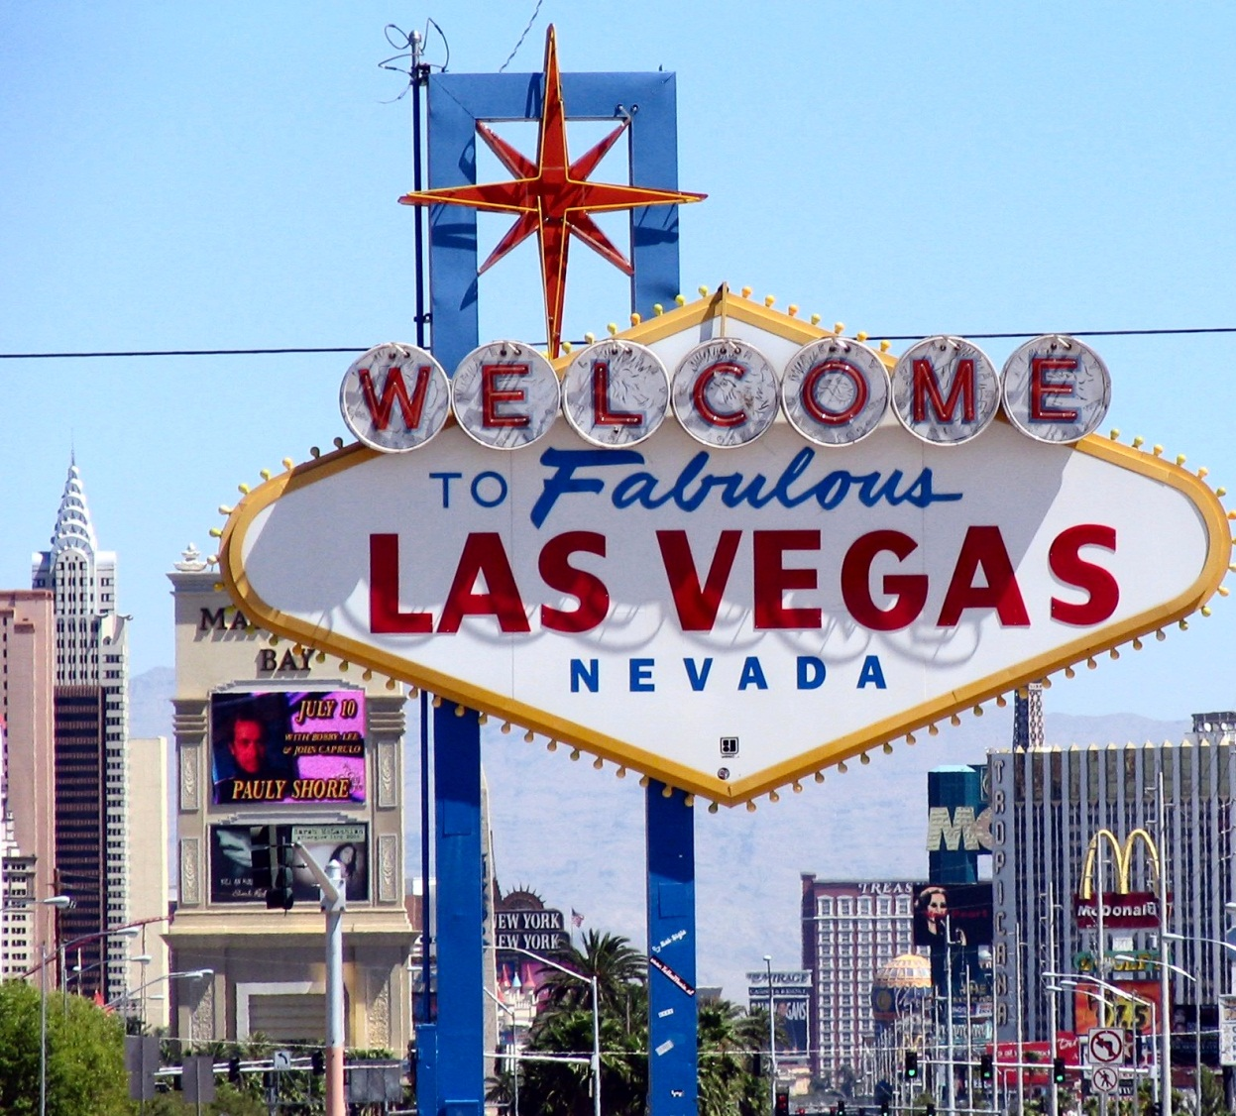
Welcome to Las Vegas

Slide 4

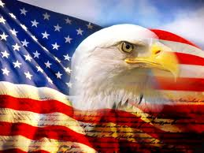
Notes:
4
Please stand for out National Anthem

Slide 5
No participant shall be allowed to discuss any subject relating to prices charged, discounts offered of any nature, specific hourly rates, employee benefits, or agreements made with third party entities. Should any discussion of these items take place, said participant will be asked to refrain immediately, disregarding any pursuant discussion. Should said party deny such request, this meeting will be immediately disbanded.
Antitrust Guidelines
Notes:
Just like the safety announcement in the airplane

Slide 6
The Collision Industry Conference (CIC) is a forum where collision industry stakeholders come together to discuss issues, build broad understanding, find common ground and communicate to the industry at-large, findings and possible solutions.
Mission Statement

Slide 7
A collision industry in which all segments work together efficiently, effectively, ethically and respectfully to enable complete and safe repair of the vehicle while facilitating the most pleasant possible experience for our mutual customer, the consumer.
Vision Statement

Slide 8

  Restrooms
  Emergency exits
  Cell phones
Housekeeping

Slide 9
Any first time CIC participants?
  Welcome to participate
  Join Committees
  Open Microphone
  Ask Questions
Housekeeping
Notes:
Welcome
I may not know who you are so find me and please introduce yourself
You will see committee activity – welcome to join
Open Microphone scheduled tomorrow – chance to hear committees and attend reception
Ask questions! All stakeholders!!! Chance to talk to others and hear another perspective.

Slide 10
Collision Industry Conference
Level One Sponsors
Level Two Sponsors
1-800 Radiator & A/C
3M Automotive Aftermarket
AkzoNobel Coatings
ALLDATA
AudaExplore, a Solera Company
Caliber Collision Centers
Car-Part.com
CARQUEST Auto Parts & Paint
CCC Information Services
ChemSpec
Chief Automotive Technologies
Coyote Vision Group
Square One Systems
CSi Complete & TenPoint
Insurance Solutions
Enterprise Rent-A-Car
Ford Customer Service
General Motors –
Customer Care & Aftersales
ITW Evercoat
Kent Automotive
LKQ / Keystone
Lord Corporation
Matrix Electronic Measuring
Matrix System Automotive Finishes
Mitchell International
National Coatings
Norton Saint-Gobain
Paint, Body & Equipment Distributors,
a segment of AAIA
Parts Trader
Sherwin-Williams Automotive Finishes
State Farm Insurance
Sterling Autobody Centers
Toyota Motor Sales, USA
United Recyclers Group

Slide 11
Welcome to Las Vegas

Slide 12

Wednesday
Thursday
Agenda

Slide 13
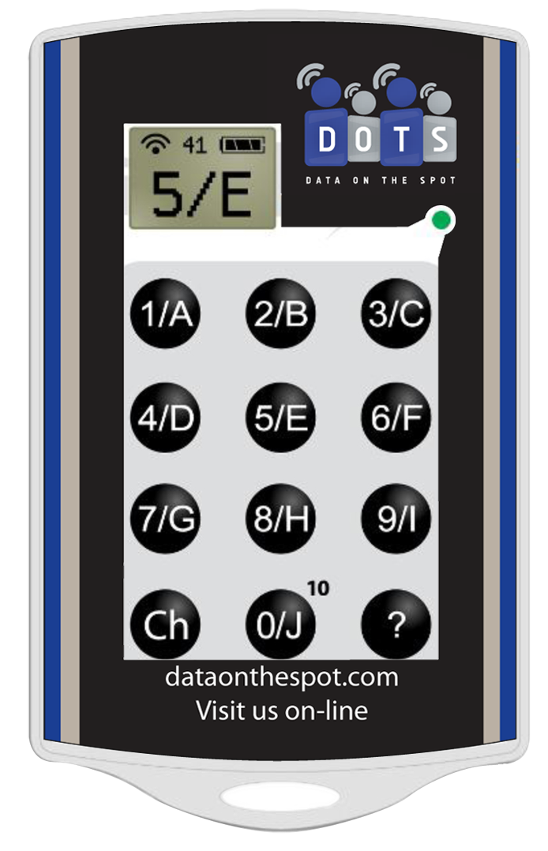
Audience Response System

Slide 14
Image of the keypad in the corner
Press the appropriate number / letter
Your first answer will power on the keypad and send your response.
Change your response as many times as you want, only last entry is recorded.
All responses are anonymous.
Audience Response System

Slide 15
If the term HFO1234YF comes up as a topic at the dinner table what would you do?
Say, I am happy with my cable company
Say, you don’t know anything about Health Care.
Change the subject quick because somebody wants to talk about auto AC Refrigerants.
Audience Response System
Notes:
Read question, answers, then question again

Slide 16
Global Warming Potential (GWP) scores for automotive refrigerants.
R-12 - Freon® GWP = 2,400
R-134a - Suva® GWP = 1,300
R1234yf - Opteon® GWP = 4
R744 - CO2 (No Name yet) GWP = 1
Audience Response System
Notes:
Read question, answers, then question again

Slide 17
A new type of equipment is required to recover, recycle and recharge systems with R1234yf.
True
False
Audience Response System
Notes:
Read question, answers, then question again

Slide 18
R1234YF is Flammable
True
False
Audience Response System
Notes:
Read question, answers, then question again

Slide 19
True. This has “sparked” some debate within the vehicle manufacturing community. Several German vehicle manufactures are shunning R1234yf and are forging ahead with development of a CO2 refrigerant.
The challenge with R744 (CO2) is the very high pressure.
(high side pressures is 1,800 psi or more)
Audience Response System
Notes:
Read question, answers, then question again

Slide 20
Which manufacturer was the first to use R1234YF in the US market?
General Motors
Mercedes
Volvo
Audience Response System
Notes:
Read question, answers, then question again

Slide 21
2013 Review
Definitions Committee
CIC Website
2014 Planning Meeting
Chairman Comments

Slide 22
Industry Announcements
November 2013
Las Vegas Nevada
Notes:
22

Slide 23
Human Resources Committee
November 2013
Las Vegas Nevada
Notes:
23

Slide 24
Let’s play….
Is it legal?

Slide 25
1.
Employee is injured riding dirt bikes on his day off. Brings in a note from his doctor saying he needs 6 weeks off to recover.
Can you just terminate the employee?
Yes / No

Slide 26
No.
How many employees do you have?
FMLA applicable?
ADA Compliance!
Must engage in the
“Interactive Process”

Slide 27
2.
An employee has been out on a workers compensation leave of absence for a year. We have been paying his medical insurance the whole time.
Can I stop paying his medical insurance premiums?
Yes / No / It Depends

Slide 28
It Depends.
Covered by FMLA?
If so, is FMLA LOA exhausted?
ERISA-approved plan?
COBRA!

Slide 29
3.
John, your underperforming estimator, goes “out on disability.” The “fill-in” employee, Mary, has been doing fantastic. You know you can’t fire John without a discrimination lawsuit, but you really want Mary doing the job. You decide you won’t fire John, instead you will “downsize” and “eliminate the estimator position.” You give Mary the title “Customer Service Representative” to cover your tracks. When John returns you tell him “sorry, we downsized and eliminated the estimator position.”
Legal? Yes / No

Slide 30
Nice Try, but NO!
This is called a “pretext”…
And you likely will lose the disability discrimination claim John will file!
This is why you discipline when necessary and deal with termination issues head-on or they will bite you later. You’re a manager – act like one!

Slide 31
4.
John’s regular hourly rate is $20/hr, but we have a training rate of $10/hr. This week John worked 44 hrs, which included 4 hours at a mandatory training class on Saturday morning.
This is how I figured his pay:
40 hrs x $20/hr = $800.00
4 hrs x $15 = $60.00
[The training put him into OT, so I based his OT on his training rate.]
Total Wages = $860.00
Legal?
Yes / No / It Depends

Slide 32
It Depends….
Absent a statutorily compliant written agreement to the contrary (get legal counsel!), when an employee is paid two or more different hourly rates in an overtime workweek, the “regular rate” for calculating overtime is determined using the “weighted average method” (most states, check yours):
40 hrs x $20/hr = $800.00
4 hrs x $10/hr = $ 40.00
Straight Time Pay = $840.00
Weighted Average Regular Rate: $840/44 = $19.09
Overtime Rate: $19.09 x .5 = $9.55
Overtime Pay: 4hrs x $9.55 = $38.20
Total Wages Due: $840.00 + $38.20 = $878.20

Slide 33
5.
My techs are paid flat rate, qualify for the commission/flat-rate exemption, and I have them punch the clock.
Do I have to worry about minimum wage issues?
Yes / No

Slide 34
It depends on your jurisdiction!
In “federal/FLSA” jurisdictions, you can average the $$ over the clock hours to determine if min. wage is satisfied.

Slide 35
It depends on your jurisdiction!
Beware in California
Employer cannot average the $$ over the clock hours for min. wage compliance. Flat-rate or commission is only designed to pay for time repairing/selling, so must pay separate wages (at least min. wage) for non-productive time AND must pay separately for the mandatory rest periods!
Solutions exist – see me after…

Slide 36
Thank You!
Human Resources Committee
Cory King – Chair cking@employerlawyers.com

Slide 37
Break Time

Slide 38
Collision Industry Conference
Level One Sponsors
Level Two Sponsors
1-800 Radiator & A/C
3M Automotive Aftermarket
AkzoNobel Coatings
ALLDATA
AudaExplore, a Solera Company
Caliber Collision Centers
Car-Part.com
CARQUEST Auto Parts & Paint
CCC Information Services
ChemSpec
Chief Automotive Technologies
Coyote Vision Group
Square One Systems
CSi Complete & TenPoint
Insurance Solutions
Enterprise Rent-A-Car
Ford Customer Service
General Motors –
Customer Care & Aftersales
ITW Evercoat
Kent Automotive
LKQ / Keystone
Lord Corporation
Matrix Electronic Measuring
Matrix System Automotive Finishes
Mitchell International
National Coatings
Norton Saint-Gobain
Paint, Body & Equipment Distributors,
a segment of AAIA
Parts Trader
Sherwin-Williams Automotive Finishes
State Farm Insurance
Sterling Autobody Centers
Toyota Motor Sales, USA
United Recyclers Group

Slide 39
Insurance-Repairer Relations/
Parts and Materials
Las Vegas 2013
Bright light city gonna set my soul on fire
Notes:
39

Slide 40
Aaron Schulenburg, SCRS
Al Estorga, Estorga’s
Anthony Klein, eSurance
Barry Dorn, Dorn’s AutoBody
Bill Bebinger, Nationwide
Bill Lawrence, LC Automotive
Bob Smith, Repair Advocate
Brett Downs, 1800Radiator
Carl Garcia, Carl’s Collision
Chris Andreoli, Progressive
Chris Donnelly, Bodyworks Collision
Darrell Amberson, LaMettry’s
Domenic Brusco, PPG
Doug Graff, State Farm
Doug Irish, VeriFacts
Erik Sumen, Class Auto
Farzam Afshar, VeriFacts
Gary Wano, G W and Sons
Guy Maniscalo, Collision Centers of America
James Giles, ANPAC
Joe Lacy, GEICO
Insurer-Repairer Relations Committee 2013

Slide 41
Joe Laurentino, Esurance
John Palumbo, Parts Channel
John Prozinski, ASI Claims
John Vito, Hertz
Jordan Hendler, WMABA
Kevork Kahwajian, Fix Auto
Liz Stein, APN
Marcy Tieger, Symphony Advisors
Mark Allen, Audi
Mark Houde, The Traveler’s
Mike Condon, Condon Consulting
vvvv
Mike Lloyd, California Casualty
Mike Manika, CarFax
Mike Quinn, u-Parts
Peter James, ICC Group
Randy Hanson, Allstate
Richard Perry, Chief
Rod Enlow, CCAR
Ron Vincenzi, Oakland Auto Body
Russell Thrall, Quandec
Vatche Derderian, Fix Auto Pasadena and Whittier
Insurer-Repairer Relations Committee 2013

Slide 42
The CIC Vision
A collision industry in which all segments work together efficiently, effectively, ethically and respectfully to enable complete and safe repair of the vehicle while facilitating the most pleasant possible experience for our mutual customer, the consumer.
Insurer-Repairer Relations Committee 2013

Slide 43
The CIC Mission Statement
A forum where collision industry stakeholders come together to discuss issues, build broad understanding, find common ground and communicate to the industry at-large, findings and possible solutions
Insurer-Repairer Relations Committee 2013

Slide 44
Mission: Improve the relationship between insurers and repairers
Strategies
  Open dialogue and communication
  Level-setting expectations
  Establishment and adoption of “Best Practices”/“Most Beneficial” practices when appropriate
  Identify areas for insurers and repairers to work together for efficiencies (TP3)
Insurer-Repairer Relations Committee 2013

Slide 45
Panel Discussion
Parts Procurement Mandates
Randy Stabler, Pride Collision
David Priest, AutoNation
Jim Sowle, Sewell Lexus
Terry Fortner, LKQ Corp
Andy Dingman, Dingman’s Collision
Michael Quinn, uParts
Darren Huggins, Van Tuyl Group
Nick Bossinakis, OPSTRAX
Insurer-Repairer Relations Committee 2013

Slide 46
Please indicate which stakeholder group you represent.
Repairer
Insurance
OEM
Supplier
Salvage
Consultant
Education
Associations
Other
0 of 350

Slide 47
Suppliers Only: I would prefer to sell my product based on my unique value proposition versus relying on third-party intervention
Agree
Disagree
0 of 350
Insurer-Repairer Relations Committee 2013

Slide 48
Repairers Only: My facility currently uses an electronic parts procurement system
Of my choosing
Due to insurer agreements
I don’t use one
0 of 350
Insurer-Repairer Relations Committee 2013

Slide 49
Repairers Selected System: Has the system affected your efficiency?
Positively
Negatively
No change
0 of 350
Insurer-Repairer Relations Committee 2013

Slide 50
Repairers Selected System : Has the system affected the quality of parts you receive?
Positively
Negatively
No change
0 of 350
Insurer-Repairer Relations Committee 2013

Slide 51
Repairers Selected System : Has the system affected your customer’s experience?
Positively
Negatively
No change
0 of 350
Insurer-Repairer Relations Committee 2013

Slide 52
Insurer Selected System: Has the system affected your efficiency?
Positively
Negatively
No change
0 of 350
Insurer-Repairer Relations Committee 2013

Slide 53
Insurer Selected System : Has the system affected the quality of parts you receive?
Positively
Negatively
No change
0 of 350
Insurer-Repairer Relations Committee 2013

Slide 54
Insurer Selected System : Has the system affected your customer’s experience?
Positively
Negatively
No change
0 of 350
Insurer-Repairer Relations Committee 2013

Slide 55
Repairers Only: My overall experience with the insurer-selected parts procurement system has been
Positive
Negative
Neutral
Audience Response Template
0 of 350

Slide 56
Repairers Only: My facility uses more than one parts procurement system because of my agreement(s) with an insurer
True
False
0 of 350
Insurer-Repairer Relations Committee 2013

Slide 57
Repairers Only: I would give up the referral volume that I currently receive in order to avoid using a system selected by an insurer
Agree
Disagree
0 of 350
Insurer-Repairer Relations Committee 2013

Slide 58
Repairers Only: My facility uses some type of system as a result of insurance agreements (e.g. information provider, CSI, anything)
True
False
0 of 350
Insurer-Repairer Relations Committee 2013

Slide 59
Repairers Only: My overall experience with systems required by insurer intervention has been
Positive
Negative
Neutral
0 of 350
Insurer-Repairer Relations Committee 2013

Slide 60
Repairers Only: My facility should be able to select any system that we want to use without insurer intervention
Agree
Disagree
0 of 350
Insurer-Repairer Relations Committee 2013

Slide 61
Open Microphone
~~~~~~~
~~~~~~~
~~~~~~~
~~~~~~~

Slide 62
Questions?
Rick Tuuri: Chair/Lame Duck
Rick.tuuri@audaexplore.com
Randy Hanson: Vice-Chair/Chair Apparent
RHanson2@allstate.com
Insurer-Repairer Relations Committee 2013

Slide 63
Collision Industry Conference
Level One Sponsors
Level Two Sponsors
1-800 Radiator & A/C
3M Automotive Aftermarket
AkzoNobel Coatings
ALLDATA
AudaExplore, a Solera Company
Caliber Collision Centers
Car-Part.com
CARQUEST Auto Parts & Paint
CCC Information Services
ChemSpec
Chief Automotive Technologies
Coyote Vision Group
Square One Systems
CSi Complete & TenPoint
Insurance Solutions
Enterprise Rent-A-Car
Ford Customer Service
General Motors –
Customer Care & Aftersales
ITW Evercoat
Kent Automotive
LKQ / Keystone
Lord Corporation
Matrix Electronic Measuring
Matrix System Automotive Finishes
Mitchell International
National Coatings
Norton Saint-Gobain
Paint, Body & Equipment Distributors,
a segment of AAIA
Parts Trader
Sherwin-Williams Automotive Finishes
State Farm Insurance
Sterling Autobody Centers
Toyota Motor Sales, USA
United Recyclers Group

Slide 64



Administrative Announcements
Mr. Jeff Hendler
2013
Nov
Notes:
Introduce Mr. Jeff Hendler

Slide 65
Have a great day!

Slide 66
Collision Industry Conference
Level One Sponsors
Level Two Sponsors
1-800 Radiator & A/C
3M Automotive Aftermarket
AkzoNobel Coatings
ALLDATA
AudaExplore, a Solera Company
Caliber Collision Centers
Car-Part.com
CARQUEST Auto Parts & Paint
CCC Information Services
ChemSpec
Chief Automotive Technologies
Coyote Vision Group
Square One Systems
CSi Complete & TenPoint
Insurance Solutions
Enterprise Rent-A-Car
Ford Customer Service
General Motors –
Customer Care & Aftersales
ITW Evercoat
Kent Automotive
LKQ / Keystone
Lord Corporation
Matrix Electronic Measuring
Matrix System Automotive Finishes
Mitchell International
National Coatings
Norton Saint-Gobain
Paint, Body & Equipment Distributors,
a segment of AAIA
Parts Trader
Sherwin-Williams Automotive Finishes
State Farm Insurance
Sterling Autobody Centers
Toyota Motor Sales, USA
United Recyclers Group

