Slide 1
OE Manufacturer Disruption

Slide 2
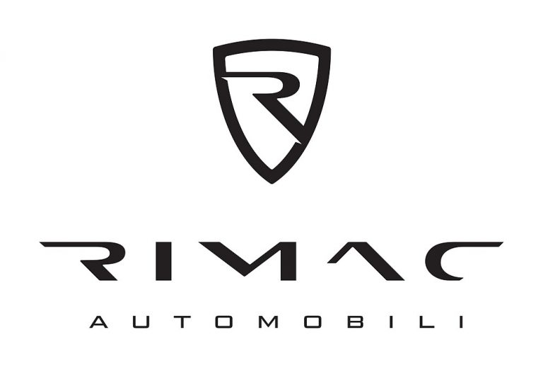
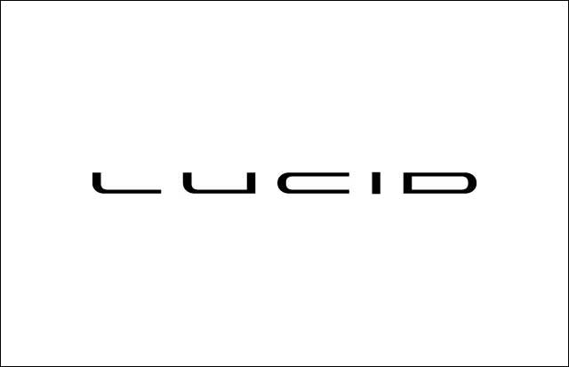
OEM Disruption

Slide 3
EV Disruption

Slide 4
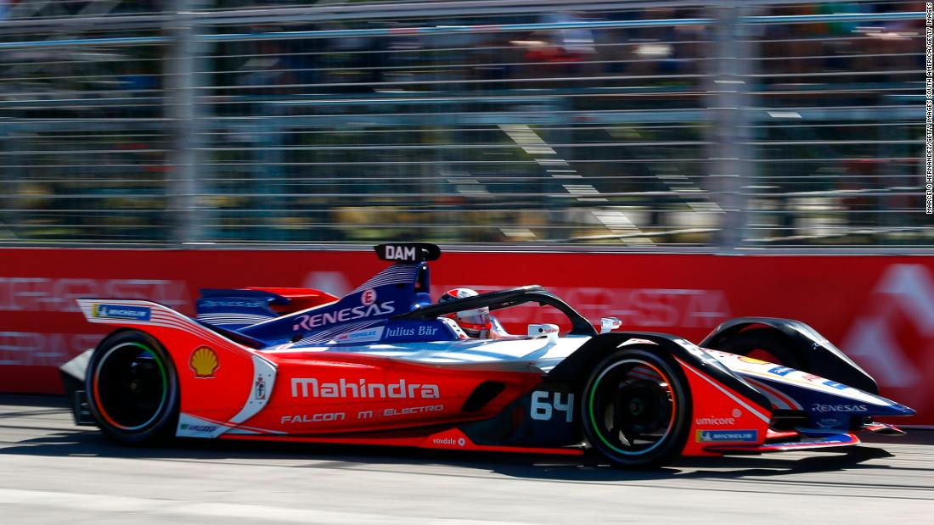
Tech companies are winning the race to electrification.

Slide 5
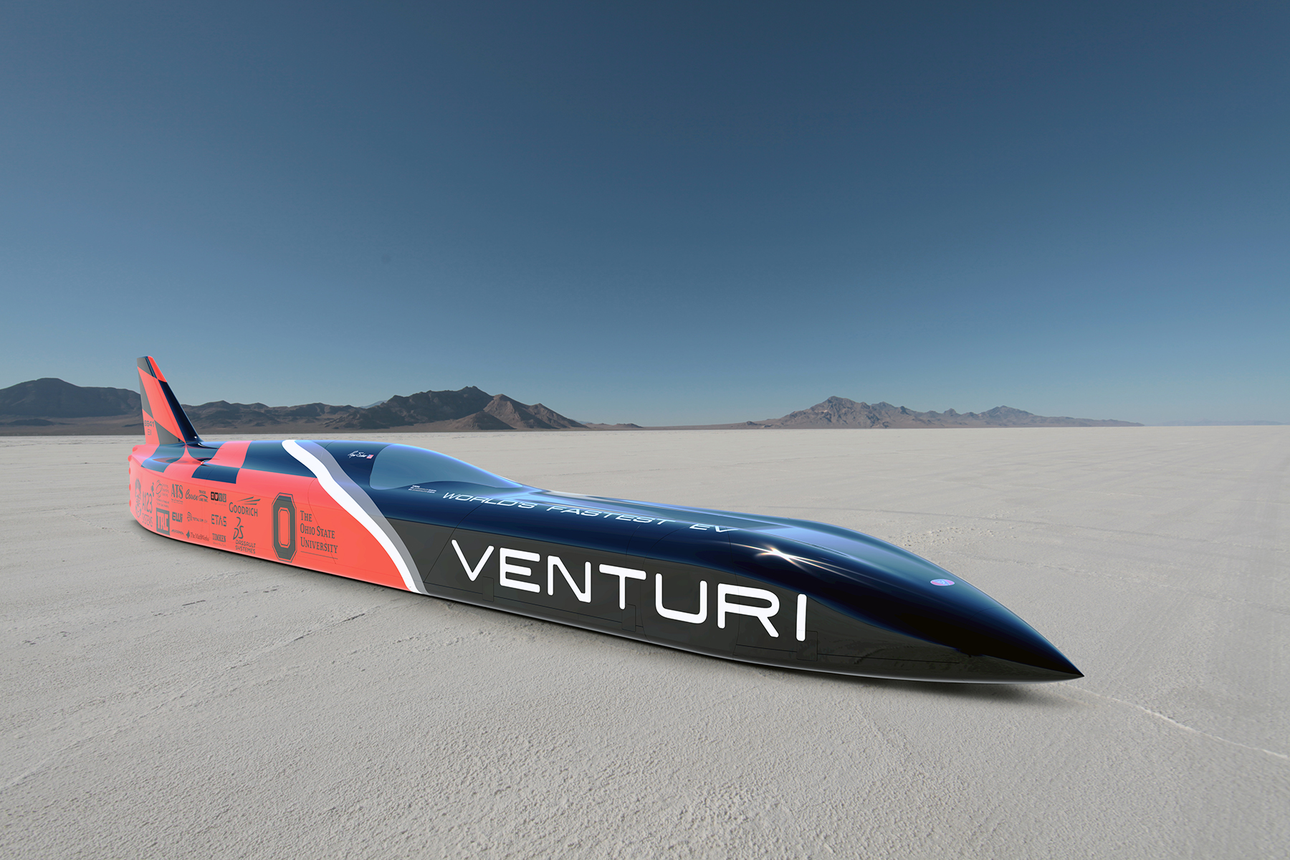
The VBB-3 is the most powerful electric car in the world.
Venturi with its VBB-3 set a land speed record for electric cars, reaching 341.4 mph on Utah’s famous Bonneville salt flats.

Slide 6
